Slide 2
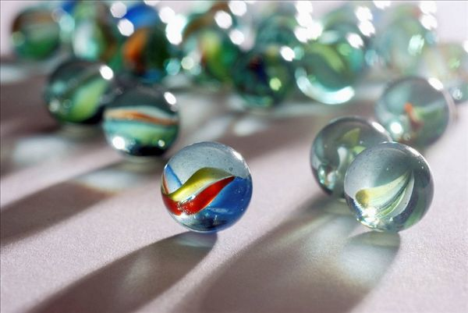

Slide 3
Jelle’s Marble Runs
How can tiny marbles
Attract the world?
PB20000296 郑滕飞

Slide 4
Early years
autism 自闭症
Jelle Bakker
Dion Bakker
Guinness World Record
marble runs marble races
teams, players and audiences

Slide 5
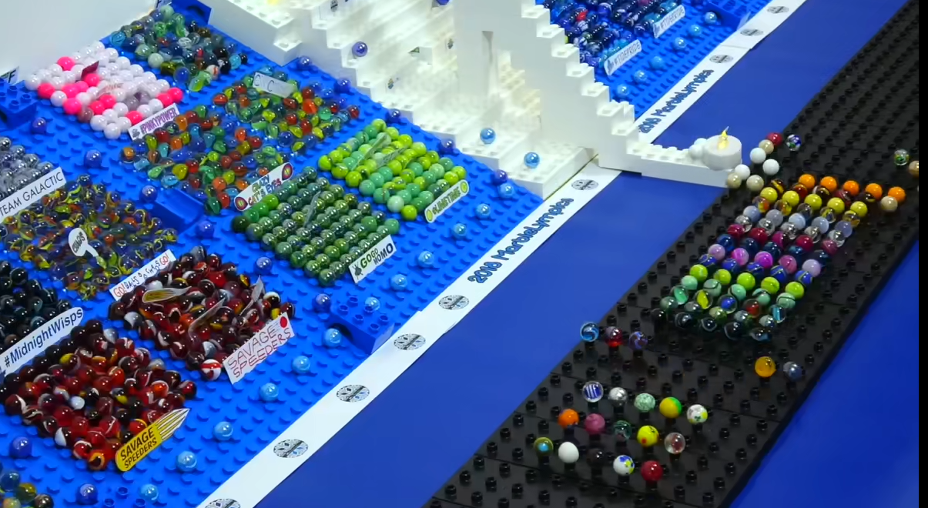
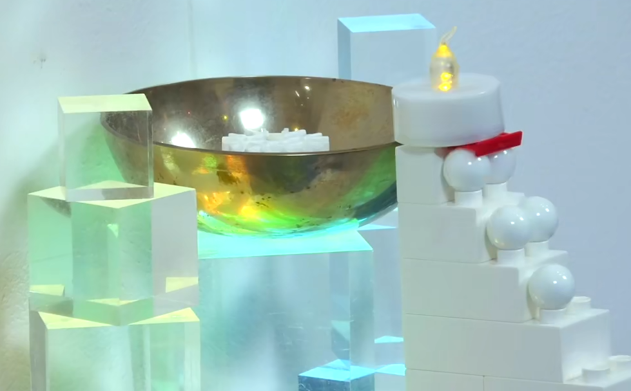
Marble Leagues
(annual league)
16 teams
Opening Ceremony
Races
Olympic flame
(retired)

Slide 6
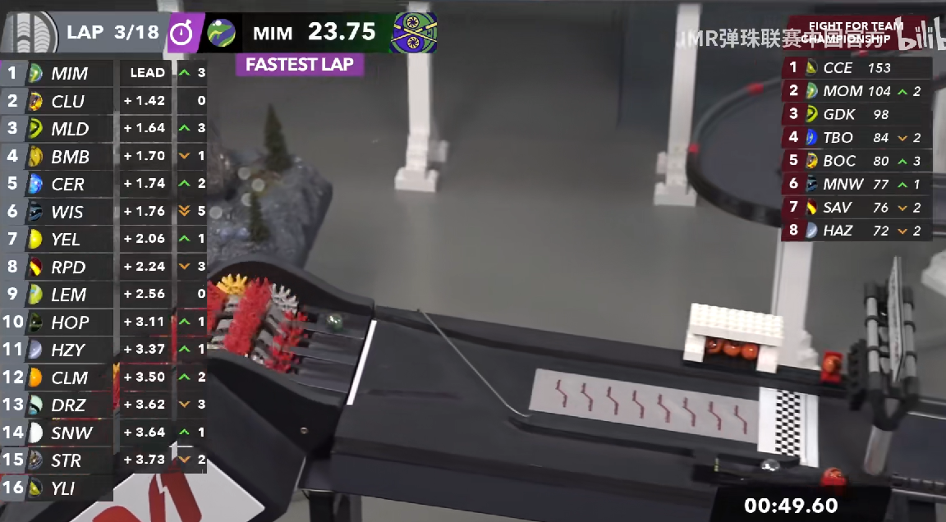
While COVID-19 threatens our lives…
Marbula 1 (Formula 1)
1’000’000 followers
I joined the JMR Chinese Official…

Slide 7
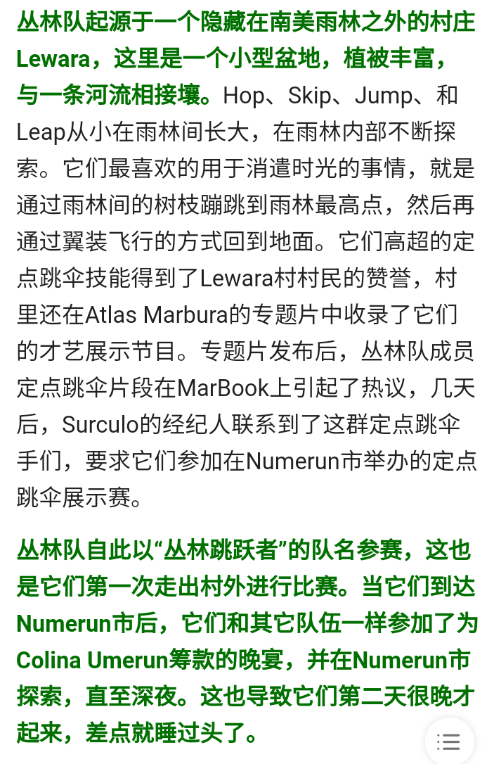
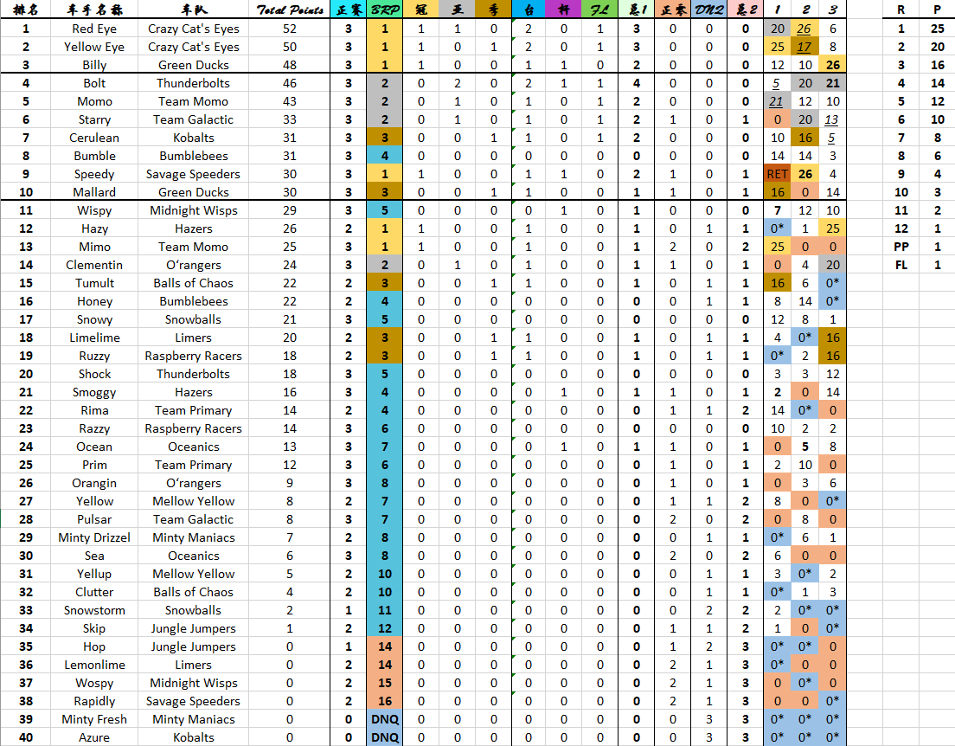
Community
Background stories
“Journalists”
Columns
Analyses
Memes

Slide 8
Why is it so popular?
Dominating
Reversing
Willpower
Friendship
Stimulants
Violence
Deals
Biases

Slide 9
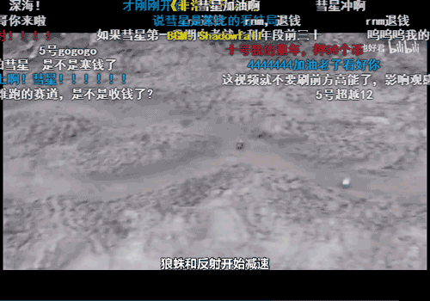
Indulge yourself in what matches should be like.

Slide 10
Thank you for listening!

Slide 11
*References & Sources
Trenaman C. Marble racing: In a world gripped by fear, marble racing proves welcome distraction[N]. CNN 2020
https://www.bilibili.com/read/cv7380959
https://www.bilibili.com/read/cv11191891
https://www.youtube.com/watch?v=uJQIIgTAM5Q&t=314s
https://www.youtube.com/watch?v=s_razQwH0Ok
https://b23.tv/PXxjrF
https://b23.tv/pIwszh

